Slide 1









wEATHER APP
Presented By Varshini A

Slide 2



brief overview of the weather app project
The Weather App project is designed to fetch and display weather information based on user input. This project is divided into two versions: a simple console-based application and a more sophisticated graphical user interface (GUI) version.

Slide 3



Comparison of easy and advanced versions
The easy version of the Weather App is a basic console application that retrieves weather information using the OpenWeatherMap API based on a city name input by the user. The advanced version enhances the user experience by providing a GUI, allowing users to input the city name and view detailed weather data more interactively.

Slide 4



Easy version
Objective: Fetch and Display Weather Information
Features
Technologies Used
The goal of the easy version is to fetch weather data based on the city name provided by the user and display it in the console.
  User input for city name.
  Weather information display (description, temperature, humidity).
  Python
  Library: requests

Slide 5

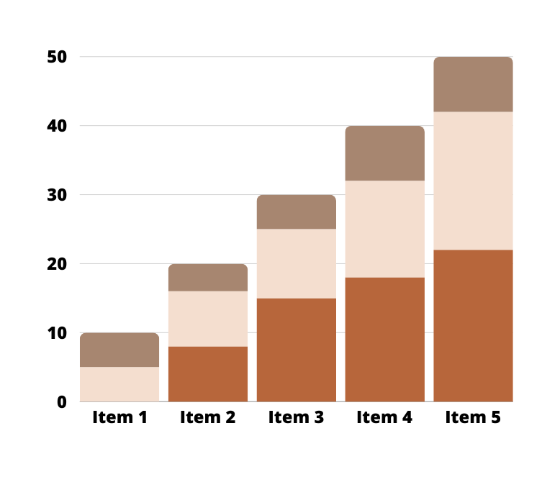
implementation
  API Integration with OpenWeatherMap: The application uses the requests library to fetch weather data from the OpenWeatherMap API.
  User Input Handling: The application prompts the user to input a city name.
  Data Display: Weather data, including description, temperature, and humidity, is displayed in the console.

Slide 6
advanced version
Objective: Provide a Graphical Interface for Weather Information
Features
Technologies Used
The advanced version aims to create a user-friendly application with a graphical interface for fetching and displaying weather information.
  GUI for user input.
  Detailed weather data display.
  Enhanced error handling.
  Python
  Libraries: tkinter, requests

Slide 7
implementation
  GUI Design with tkinter: The application uses tkinter to create a graphical interface for user interaction.
  API Integration with OpenWeatherMap: Similar to the easy version, the application uses the requests library to fetch weather data from the OpenWeatherMap API.
  Data Display and Error Handling: The weather data is displayed in the GUI, with improved error handling for invalid input or API request failures.

Slide 8



summary of both versions
Potential Future Improvements
  Extended Weather Forecasts: Provide weather forecasts for multiple days.
  Location Services Integration: Automatically fetch weather data based on the user's current location.
  Additional Weather Data: Include more detailed weather information such as wind speed, precipitation, and UV index.
  Improved User Interface: Enhance the GUI with better design elements and user experience improvements.
  Notifications and Alerts: Add functionality to notify users of severe weather alerts or significant changes in weather conditions.
The easy version of the Weather App is a simple console-based application that retrieves and displays weather data based on user input. The advanced version enhances the user experience by providing a graphical interface, making it easier and more intuitive for users to interact with the application and view weather information.

Slide 9
Thank You

